Slide 1
SPACE EXPLORATION WALKING DEBATE

Slide 2
Alien
Life
Exists

Slide 3
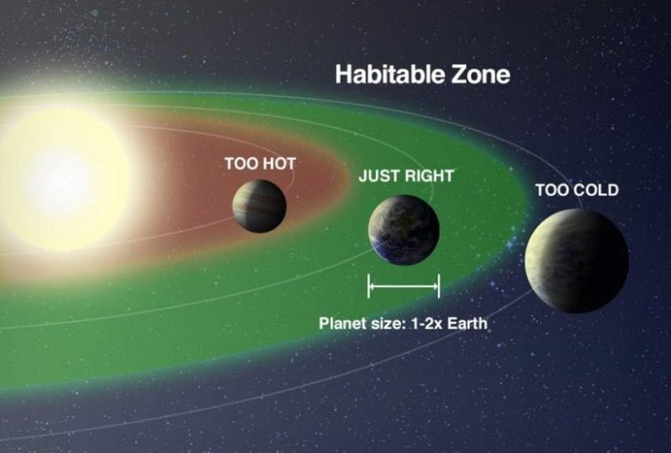
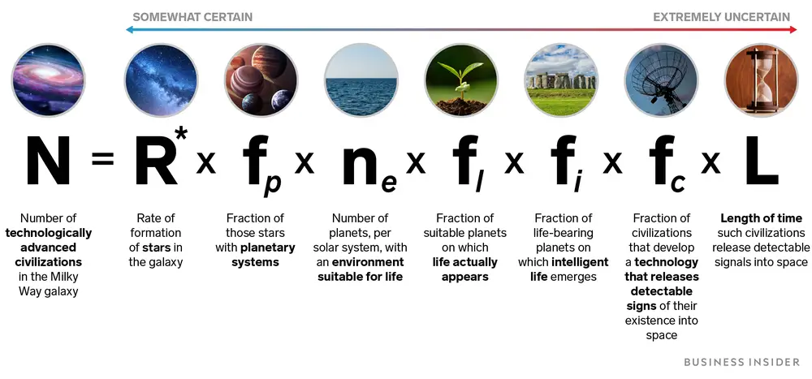
Habitable Zone
Drake Equation
Each star has a zone where liquid water could exists - an important ingredient for life to exist
It is used to calculate the probability of making contact with extraterrestrial life.

Slide 4
The government
should spend
money on
space exploration

Slide 5
SOME FACTS
Ireland
Irish Universitires
Ireland mainly invests in space exploration through ESA
(European Space Agency) €5 billion per annum
Irish Space Exploration Research occurs around the country.
UCD is currently creating technology that will be Irelands first
sateillite in space (EIRSAT-1)
Other uses
USA
The cost of providing homeless services in Dublin is expected to
reach €213 million next year,
NASA's budget for 2020 is $22.6 billion but the US government
has spent nearly $650 billion since it began.

Slide 6
'The Science'
is always
correct/true

Slide 7
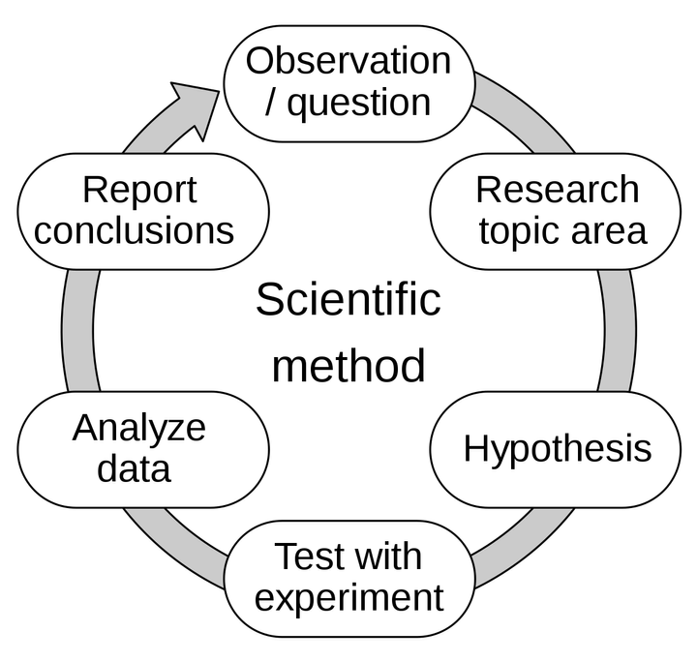
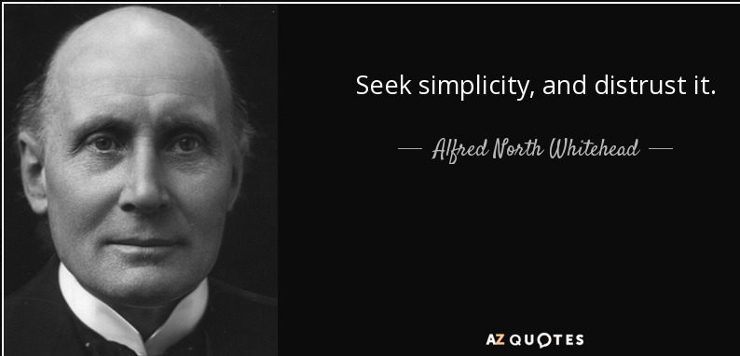
THE SCIENTIFIC METHOD
The scientific method is the process of objectively establishing facts through testing and experimentation. The basic process involves making an observation, forming a hypothesis, making a prediction, conducting an experiment and finally analyzing the results.
SCIENTISTS MAKE MISTAKES
Einstein also didn’t care for black holeshe didn’t think we could ever see it. “Of course, there is no hope of observing this phenomenon directly,” he wrote in the abstract of the Science paper introducing gravitational lensing.

Slide 8
Private space
travel should
be allowed

Slide 9
Space Adventures, Ltd., caters to space tourists by buying space on the Russian Soyuz spacecraft. Right now, the cost of a seat is $52 million.
Elon Musk is the estimated to be the wealthiest person in the world currently, and is CEO of SpaceX.
Billionaire Jared Isaacman's privately chartered from SpaceX and became the first crewed orbital mission with no professional astronauts on board. The flight, dubbed "Inspiration4," was named to commemorate the four-person crew and their associated "pillars" of support for St. Jude Children's Research Hospital in Memphis, Tennessee: leadership, hope, generosity and prosperity.

Slide 10
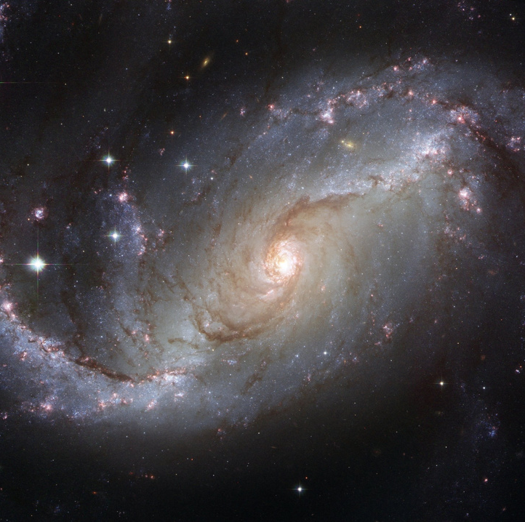
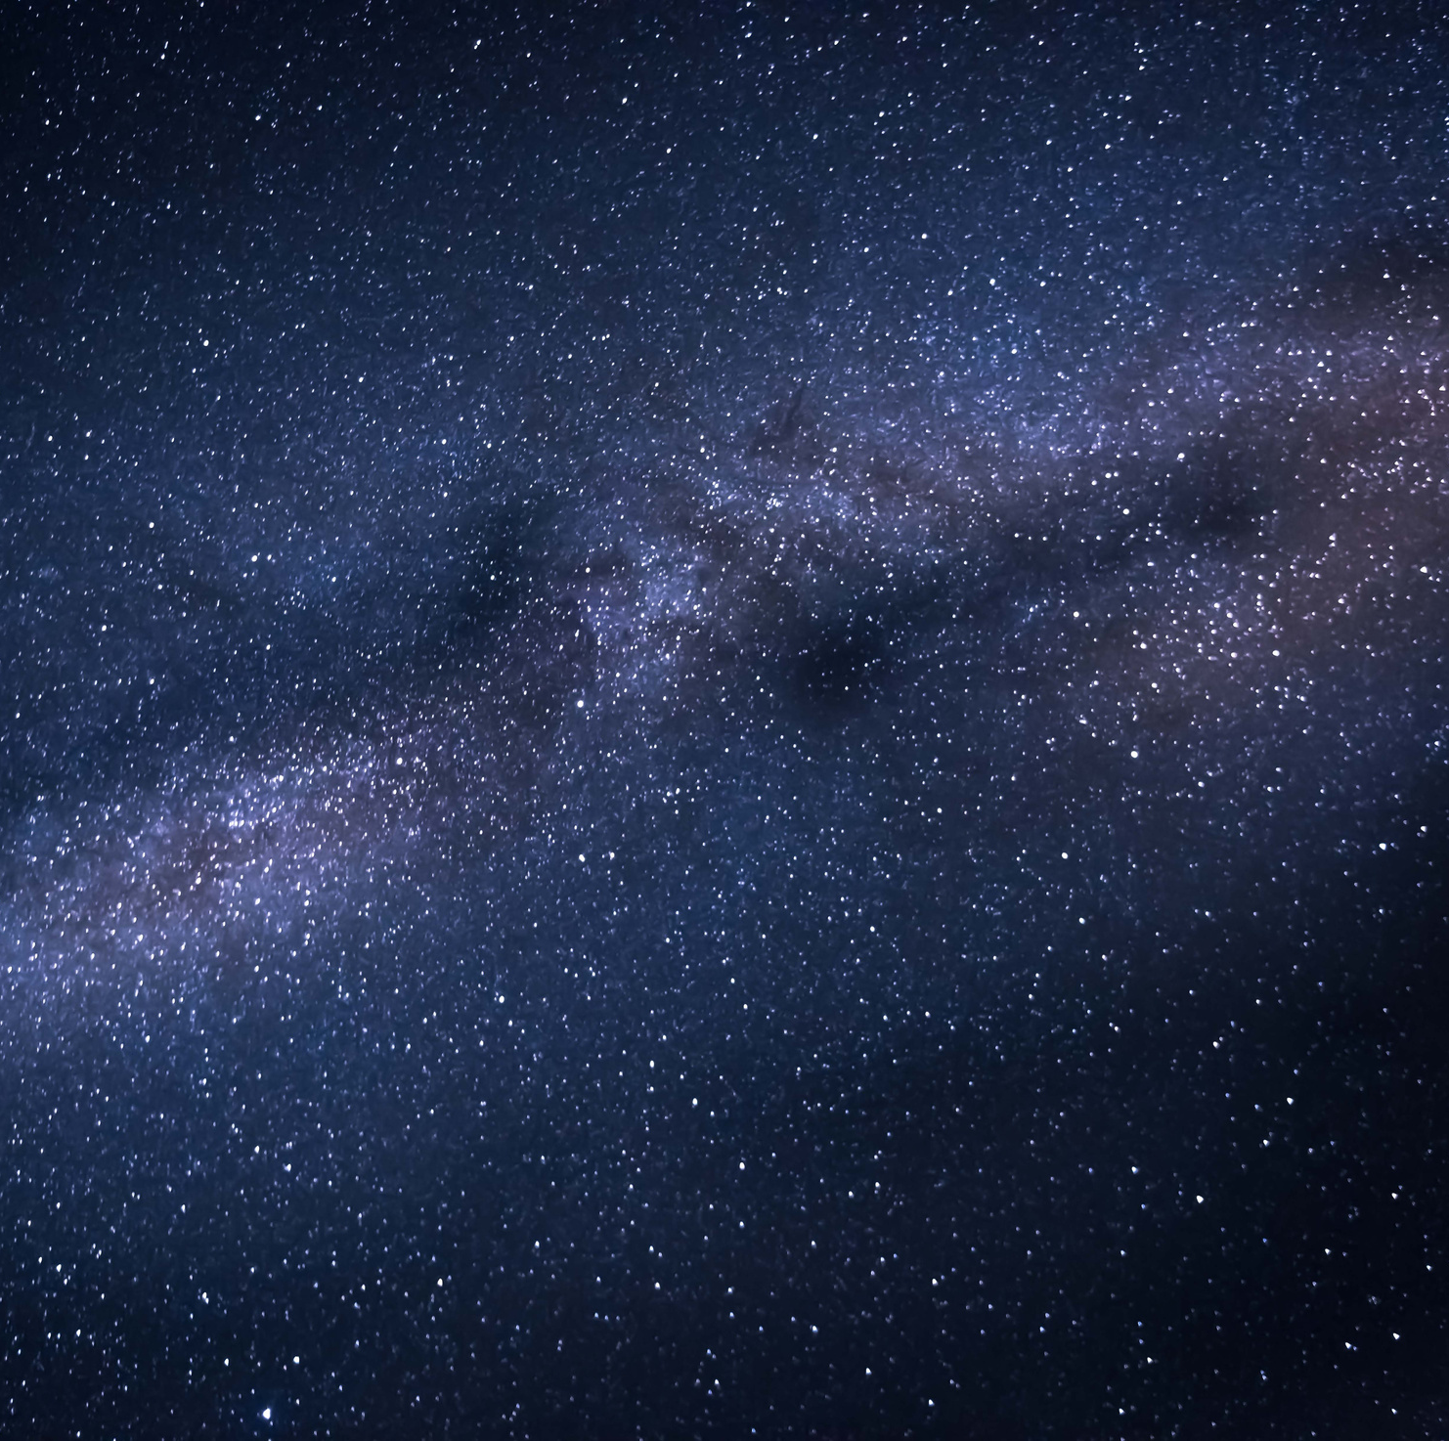
I would like
to be an
astronaut

Slide 11
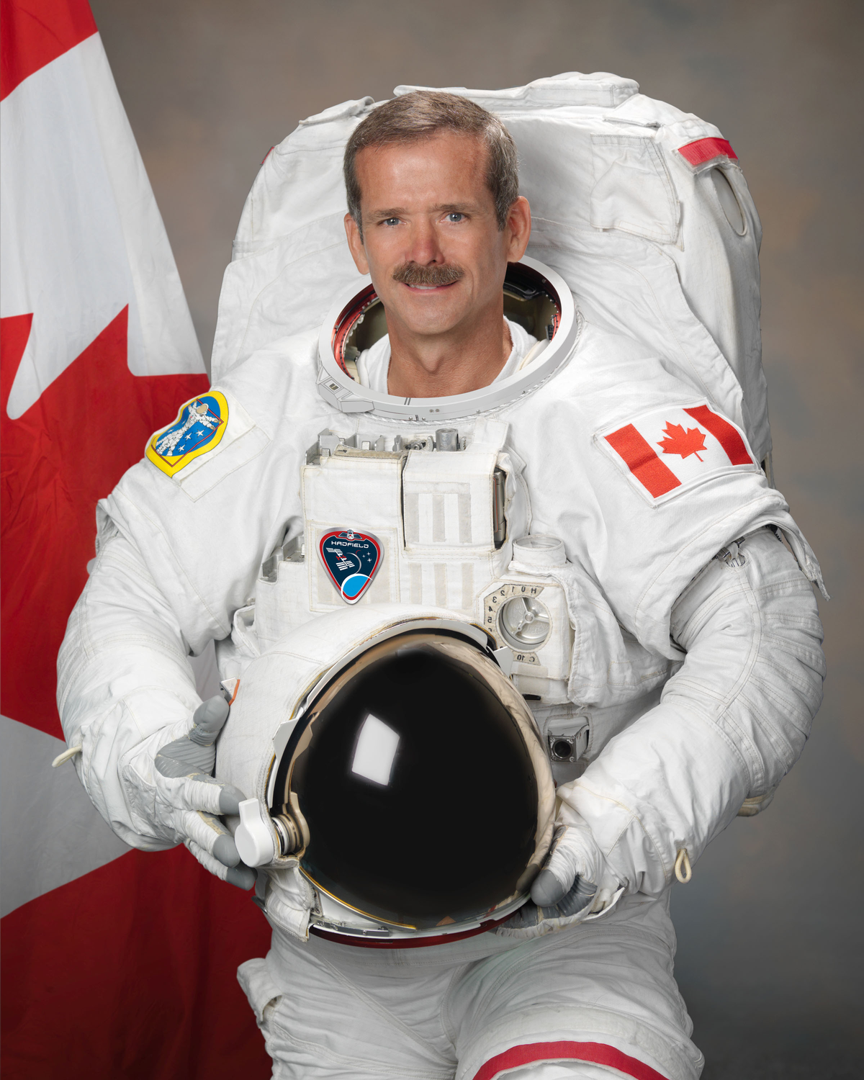
“SPACEFLIGHT ISN'T JUST ABOUT DOING
experiments, it's about an
extension of human culture.”
-- Chris Hadfield

Slide 12
Is there a duty to protect the environment on other planets?

Slide 13
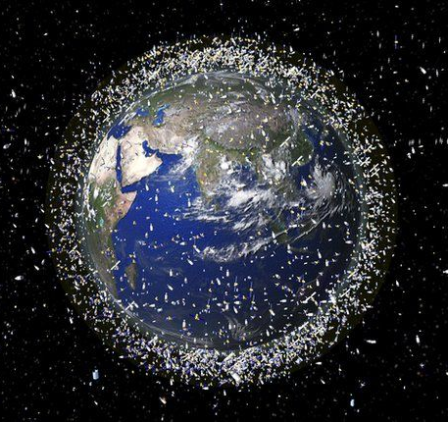
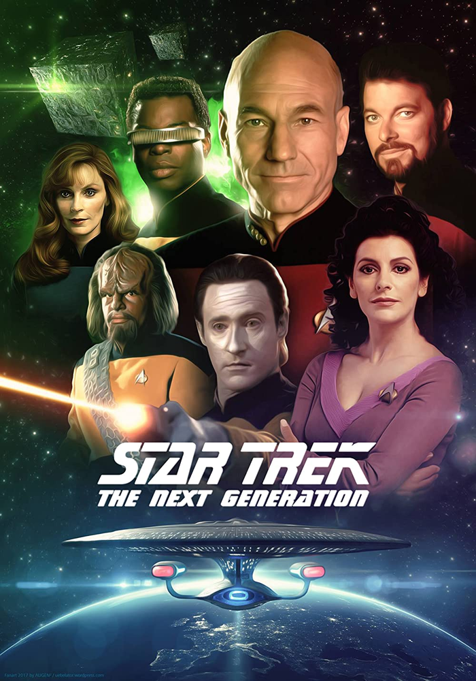
STAR TREK
General Order 1: "No starship may interfere with the normal development of any alien life or society."
SPACE DEBRIS
As of 2021, more than 27,000 pieces of space junk being tracked. There is much more debris, too small to be tracked, but large enough to threaten human spaceflight and robotic missions in the near-Earth space environment.

